Slide 1
SYNTAX ANALYSIS

Slide 2
Backus-Naur Form.
BNF stands for Backus-Naur Form or Backus Normal Form.
A meta language is a language that is used to describe another language.
BNF is a meta language (formal notations) for programming languages syntax.
A production is a rule relating to a pair of strings, say ά and β, specifying how one may be transformed into the other. This may be denoted
ά → β.
For simple theoretical grammars, upper case letters are used for non-terminals and lower case letters are used for terminals.
For more realistic grammars, such as those used to specify programming languages, the most common way of specifying productions is to use the notations invented by Backus commonly called BNF.
These notations were first introduced by Backus for describing ALGOL 58.
These notations were later modified slightly by Peter Naur for the description of ALGOL 60.

Slide 3
Backus-Naur Form.
In BNF:
  A non-terminal and terminal are usually given some descriptive names.
  Non-terminals symbols are written in angle brackets to distinguish it from a terminal symbol.
  If there are multiple definitions for the same non-terminal symbol, then they can be written as single rule, separated from each by using (|) vertical bar which means logical OR.

Slide 4
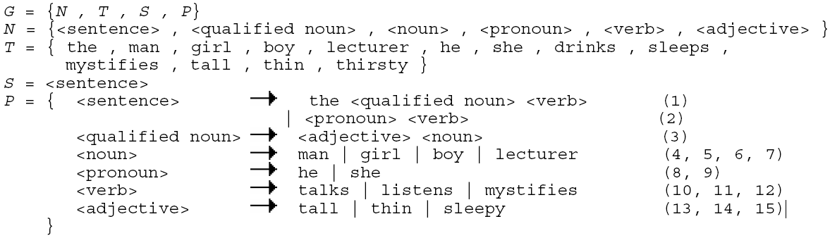
Example.
  Derive the “The sleepy boy listens” by using the above grammar.

Slide 5
Problems of a CFG.
Three types of problems are mainly faced in a CFG.
  Ambiguity.
  Left Recursion.
  Common Prefixes.
Three problems must be removed from a CFG, otherwise the grammar will not work accurately.

Slide 6
Ambiguity.
An ambiguous grammar is one that:
  Produces more than one parse trees for the same sentence.
  Produces more than one leftmost derivations or rightmost derivations for the same sentence.
A grammar becomes ambiguous when a single non-terminal appears twice or more times on the L.H.S of the production rules in the grammar.
If more than one parse trees can be produced for a sentence; then the compiler would not be able to generate the code uniquely.

Slide 7
Example.
Consider the following grammar.
<assign> → <id> = <expr>
<id> → A | B | C
<expr> → <expr> + <expr>
| <expr> * <expr>
| (<expr>)
| <id>
Now show that this grammar is ambigous for the sentence A = B + C * A.

Slide 8
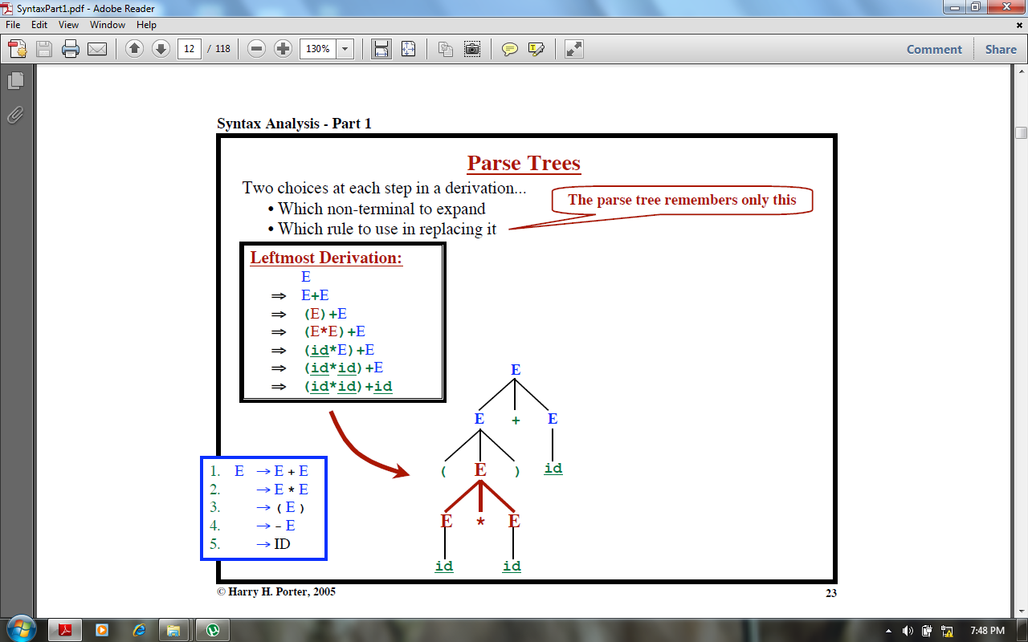

Slide 9
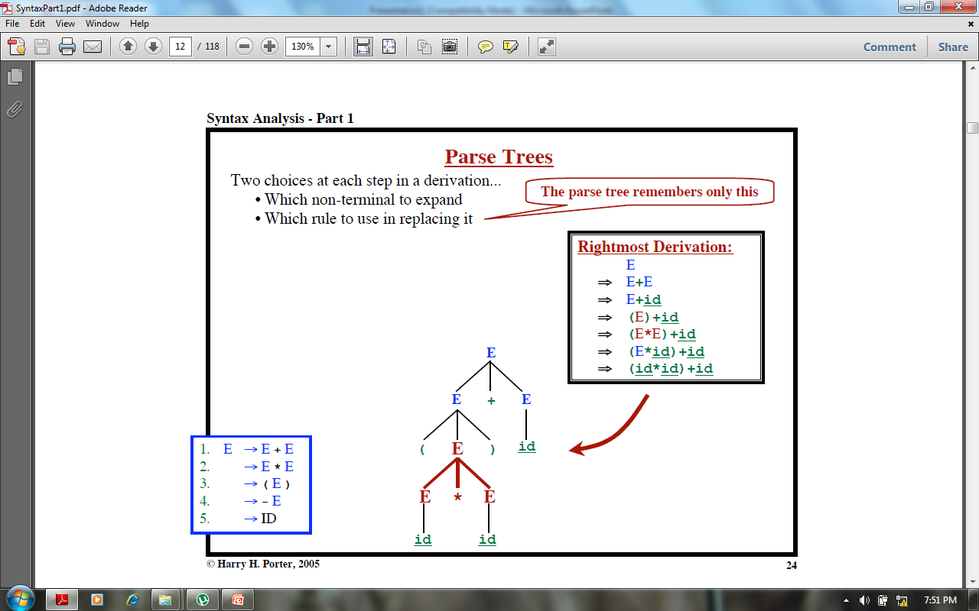

Slide 10
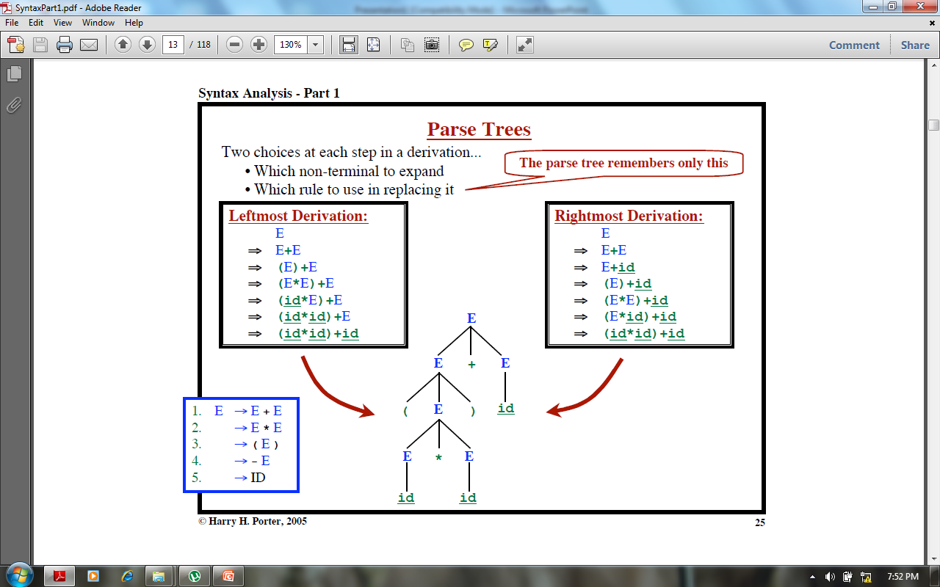

Slide 11
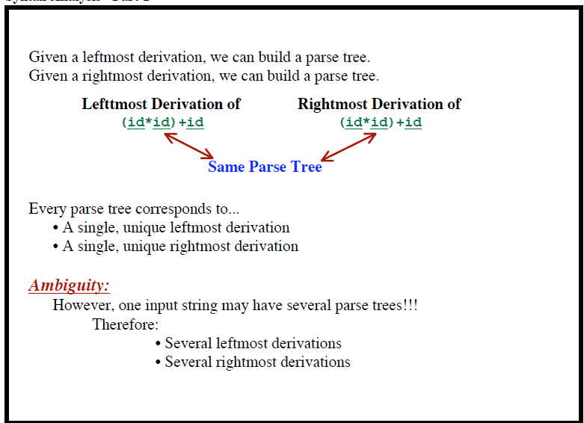

Slide 12
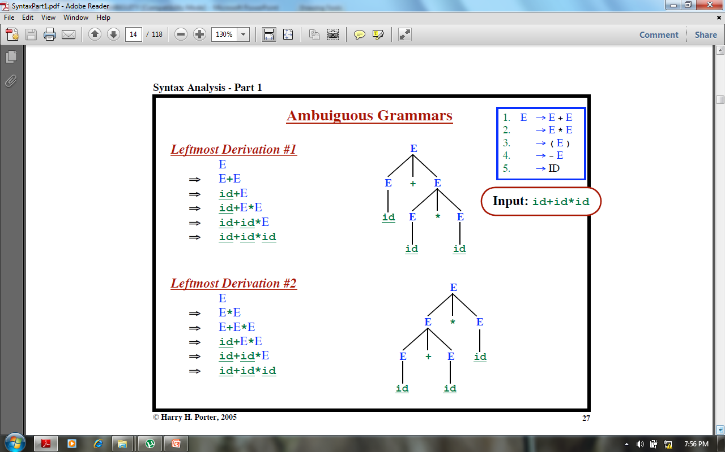

Slide 13
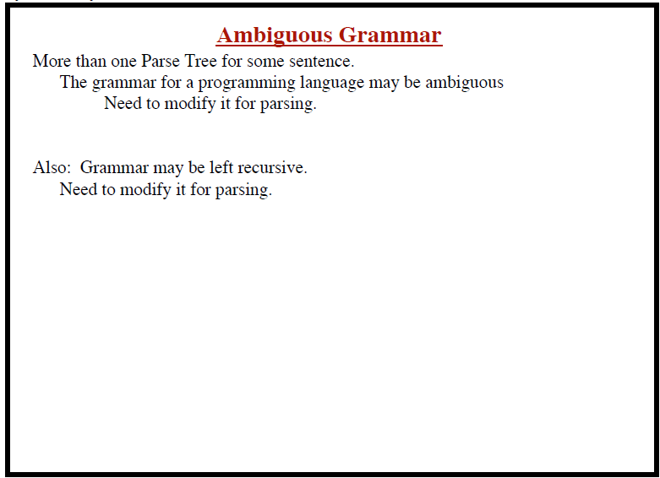

Slide 14
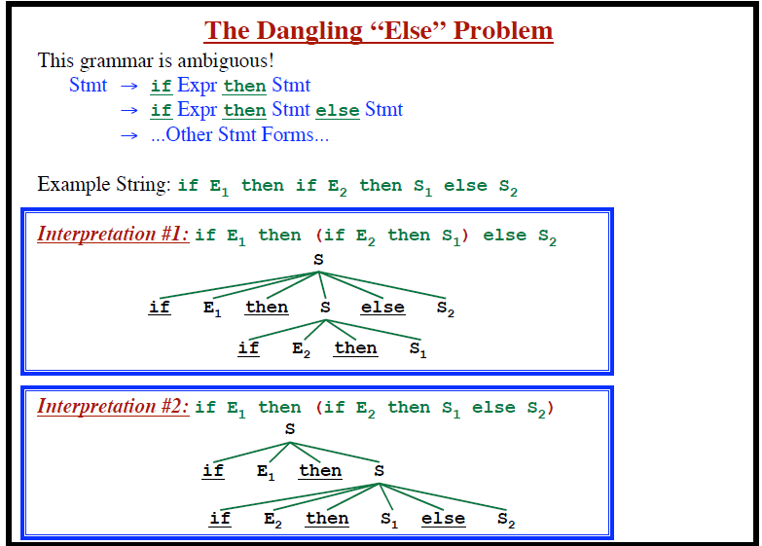

Slide 15
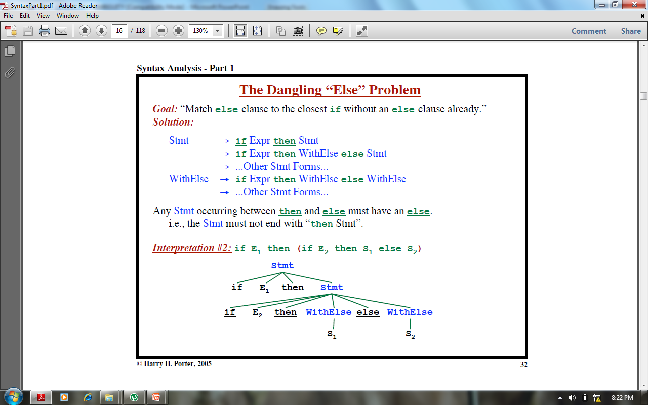

Slide 16
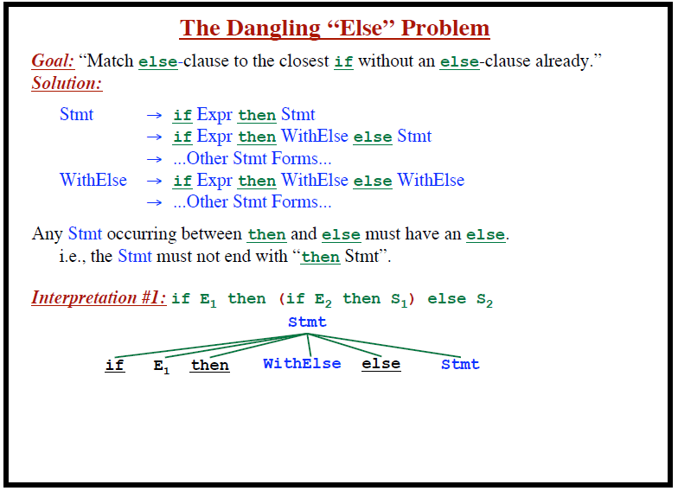

Slide 17
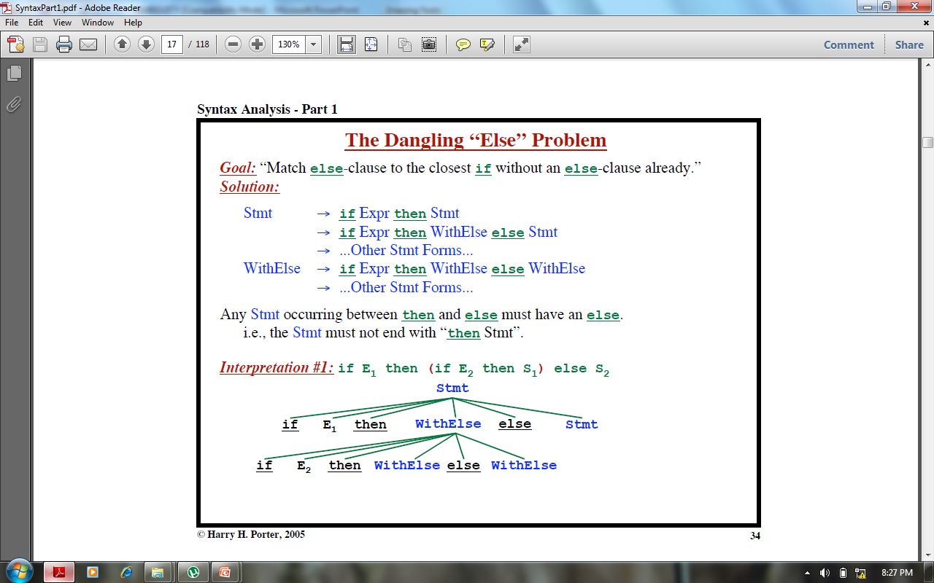

Slide 18
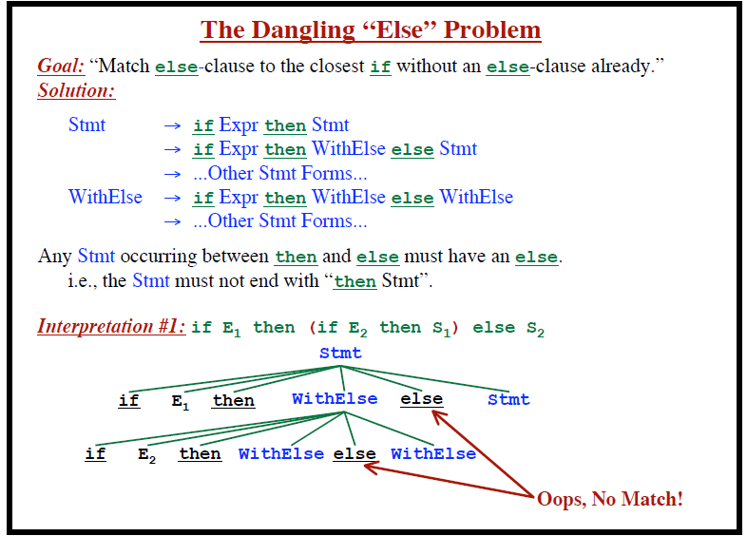

Slide 19
Null Production
Definition: The production of the form
nonterminal → ☹
is said to be null production.
Example: Consider the following CFG
S → aA|bB|☹, A → aa|☹, B → aS
Here S → ☹ and A → ☹ are null productions.
Following is a note regarding the null productions

Slide 20
Note
If a CFG has a null production, then it is possible to construct another CFG without null production accepting the same language with the exception of the word ☹ i.e. if the language contains the word ☹ then the new language cannot have the word ☹.
Following is a method to construct a CFG without null production for a given CFG

Slide 21
Null Production continued …
Method: Delete all the Null productions and add new productions e.g.
consider the following productions of a certain CFG X → aNbNa, N → ☹, delete the production N → ☹ and using the production
X → aNbNa, add the following new productions
X → aNba, X → abNa and X → aba
Thus the new CFG will contain the following productions X → aNba|abNa|aba|aNbNa
Note: It is to be noted that X → aNbNa will still be included in the new CFG.

Slide 22
Nullable Production
Definition: A production is called nullable production if it is of the form
N → ☹
or
there is a derivation that starts at N and leads to ☹ i.e.
N₁ → N₂, N₂ → N₃, N₃ → N₄, …, N_{n} → ☹, where N, N₁, N₂, …, N_{n} are non terminals.
Following is an example

Slide 23
Example
Consider the following CFG
S → AA|bB, A → aa|B, B → aS | ☹
Here S → AA and A  B are nullable productions, while B → ☹ is null a production.
Following is an example describing the method to convert the given CFG containing null productions and nullable productions into the one without null productions

Slide 24
Example
Consider the following CFG
S → XaY|YY|aX|ZYX
X → Za|bZ|ZZ|Yb
Y → Ya|XY|☹
Z → aX|YYY
It is to be noted that in the given CFG, the productions S → YY, X → ZZ, Z → YYY are Nullable productions, while Y → ☹ is Null production.

Slide 25
Example continued …
Here the method of removing null productions, as discussed earlier, will be used along with replacing nonterminals corresponding to nullable productions like nonterminals for null productions are replaced.
Thus the required CFG will be
S → XaY|Xa|aY|a|YY|Y|aX|ZYX|YX|ZX|ZY
X → Za|a|bZ|b|ZZ|Z|Yb
Y → Ya|a|XY|X|Y
Z → aX|a|YYY|YY|Y,
Following is another example

Slide 26
Example
Consider the following CFG
S → XY, X → Zb, Y → bW
Z → AB, W → Z, A → aA|bA|☹
B → Ba|Bb|☹.
Here A → ☹ and B → ☹ are null productions, while Z → AB, W → Z are nullable productions. The new CFG after, applying the method, will be

Slide 27
Example continued …
S → XY
X → Zb|b
Y → bW|b
Z → AB|A|B
W → Z
A → aA|a|bA|b
B → Ba|a|Bb|b

Slide 28
Note
While adding new productions all Nullable productions should be handled with care. All Nullable productions will be used to add new productions, but only the Null production will be deleted.

Slide 29
Unit production
Unit production: The productions of the form
nonterminal  one nonterminal,
is called the unit production.
Following is an example showing how to eliminate the unit productions from a given CFG.

Slide 30
Unit production continued …
Example: Consider the following CFG
S → A|bb,
A → B|b,
B → S|a
Separate the unit productions from the nonunit productions as shown below
unit prods. nonunit prods.
S → A S → bb
A → B A → b
B → S B → a

Slide 31
Example continued …
S → A gives S → b (using A → b)
S → A → B gives S → a (using B → a)
A → B gives A → a (using B → a)
A → B → S gives A → bb (using S → bb)
B → S gives B → bb (using S → bb)
B → S → A gives B → b (using A → b)
Thus the new CFG will be
S → a|b|bb, A → a|b|bb, B → a|b|bb.
Which generates the finite language {a,b,bb}.

